Slide 1

Discovering Yourself Through Maths
Mr Zhao Maths Tutoring Program

Slide 2

What is Maths?
Discovery
Logic
Skills
Connection
Maths helps students discover themselves
It follows logical rules and procedures
Involves professional knowledge and practical skills
Connected to everyday life experiences

Slide 3

The Essence
Truth
Logic
Maths seeks truth and logical consistency, forming the foundation of problem-solving skills.
It encourages logical thinking and sound decision-making, crucial for everyday challenges.

Slide 4

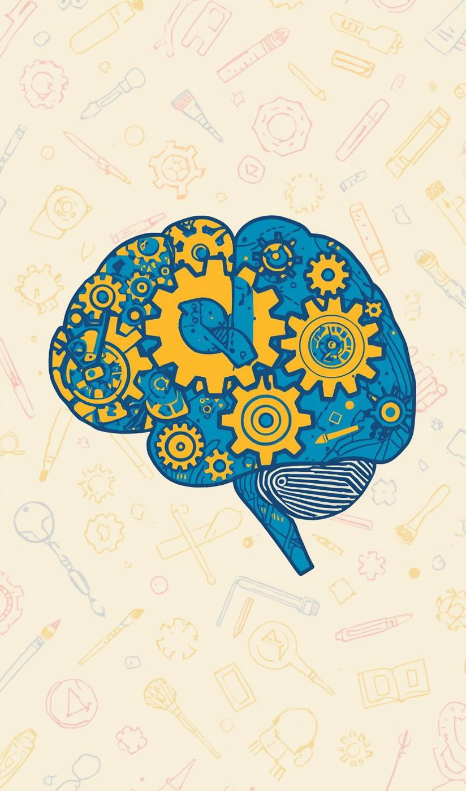
Why Maths Matters
Helps youth stay grounded and imaginative

Slide 5

The Magic of Mathematics
Exploring Creativity Through Algebra and Geometry
Maths reveals artistic beauty in shapes and forms

Slide 6
Teaching Philosophy
Mind
Relevance
Courage
Adventure
Exercising logical thinking skills
Relating maths to daily life
Encouraging adventurous learning journeys
Embracing exploration and discovery

Slide 7
Class Structure
Theory
Examples
Practice
Reinforcement
Clear explanations of concepts
Demonstrating problems step-by-step
Monitoring student progress closely
Assigning related homework tasks

Slide 8

Learning Through Exploration
Self-Discovery and Confidence in Maths
Maths encourages growth through exploration and risks

Slide 9
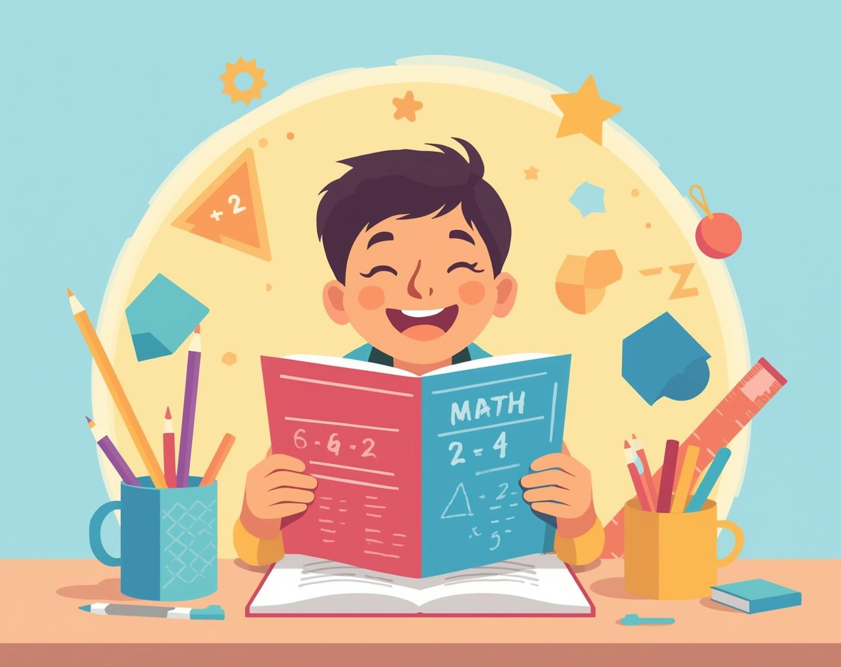
Why I Love Teaching Maths
Inspiring Student Confidence and Growth
Teaching is a passion that ignites learning

Slide 10
Let's Explore Maths Together!
Email
Social
Phone
chuhuizhao@hotmail.com
www.mrzhaomaths.com
0450 471 016

